Slide 1
Academic presentations
a few guidelines

Slide 2
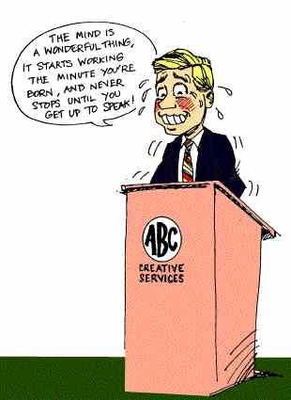

Slide 3
3 important things to bear in mind when preparing or giving a presentation:
organisation
audience
language

Slide 4
Structuring a presentation
welcome the audience
general introduction and overview
the body
the conclusion
discussion and questions

Slide 5
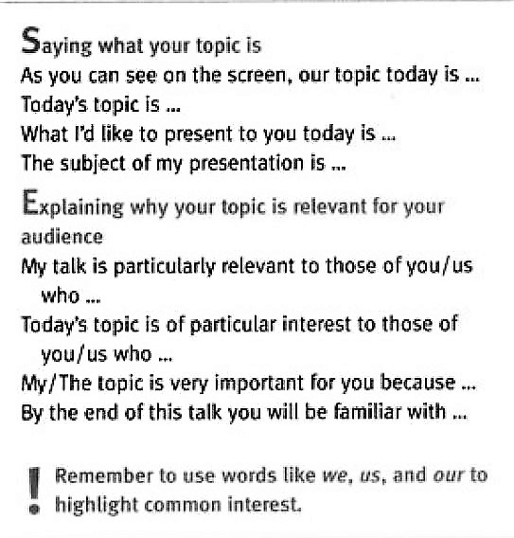
One way of introducing your presentation …
PART 1: WELCOME
say who you are and why you are there
give the presentation a title and say why you are doing it

Slide 6
another way of introducing your presentation …
PART 2: GENERAL INTRODUCTION AND OVERVIEW
set out your argument or purpose
give a brief outline of the main themes and sub-themes of your presentation

Slide 7
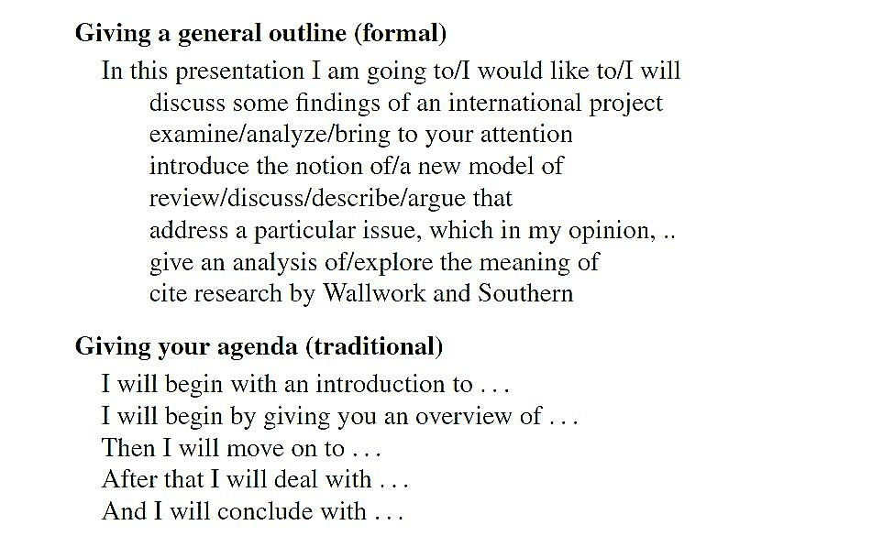

Slide 8
Useful expressions
What i’d like to do is to discuss …
I’m going to talk about …
I intend to explain …
In this presentation i’d like to focus on …
First i’ll give a brief overview of …
I’d like to begin by looking at some …
In this talk i shall …

Slide 9
Useful diction
Talk about
Outline
Describe
Explain about
Look at
Focus on
Go through
Tell you about
Highlight
Go over
Recap

Slide 10
Other options …
the presenter tells the audience a surprising fact …
… or starts by asking them a question
the presenter may consider showing the audience a picture or photograph, or ask them to listen to something

Slide 11
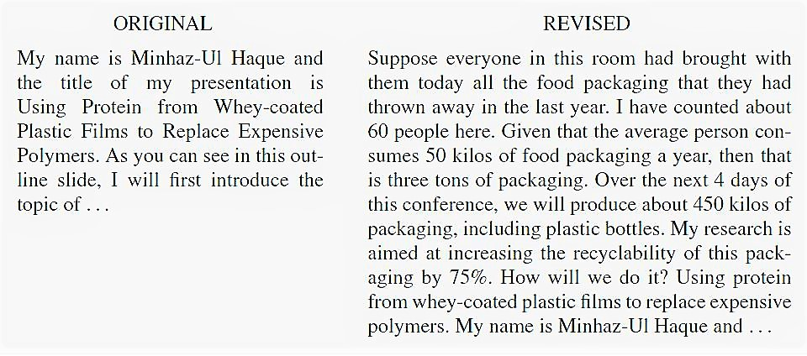

Slide 12
Concluding a presentation
The conclusion provides an opportunity to summarise what has been said
It acts as an invitation for the audience to respond to the content of the talk

Slide 13
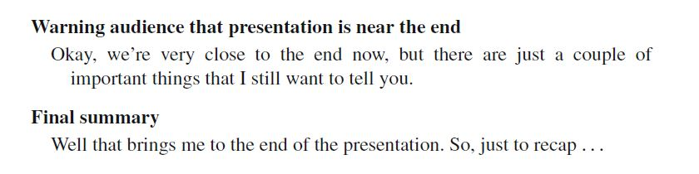
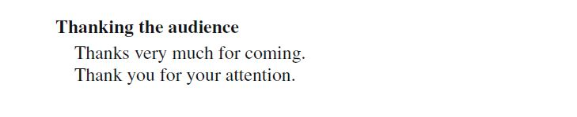

Slide 14
Questions and answers
your immediate ability to answer questions from the audience is both desirable and professional
Lead the audience to the q&a session. Ask them if they have any questions.
Always listen carefully and interpret the question before answering. And when you can’t answer, be honest.

Slide 15
